Slide 1
Sentiment Analysis on Movie Review
DEPARTMENT OF COMPUTER ENGINEERING AND APPLICATIONS
Presented by
Vivek Goyal(181500817)
Prachi Bansal(181500459)
Mani Bansal(1815100364)
Himanshi Agrawal(181500267)
Supervised By:
Mr. Navin Kumar Agrawal

Slide 2
SENTIMENT ANALYSIS
Sentiment relates to the meaning of a word or sequence of words and is usually associated with an opinion or emotion.
Sentiment analysis (also known as opinion mining) refers to the use of natural language processing, text analysis to identify and extract subjective information in source materials.
Consumers can use sentiment analysis to research products and services before a purchase. Production companies can use the public opinion to determine acceptance of their products and the public demand.
Movie-goers can decide whether to watch a movie or not after going through other people’s reviews.

Slide 3
MOTIVATION
Knowing sentiment is a very natural ability of a human being.
Can a machine be trained to do it?
SA aims at getting sentiment-related knowledge especially from the huge amount of information on the internet
Can be generally used to understand opinion in a set of documents

Slide 4
PRE-PROCESSING
All reviews were converted to lower case.
All links and urls were replaced by generic word URL
All usernames were replaced by generic word USER
Words with hashtags were replaced with the same
words without the hashtag
Punctuations and additional white spaces were removed from the reviews.
All the above work was done in python via regular expression matching. The code for preprocessing will be uploaded along with the main code.

Slide 5
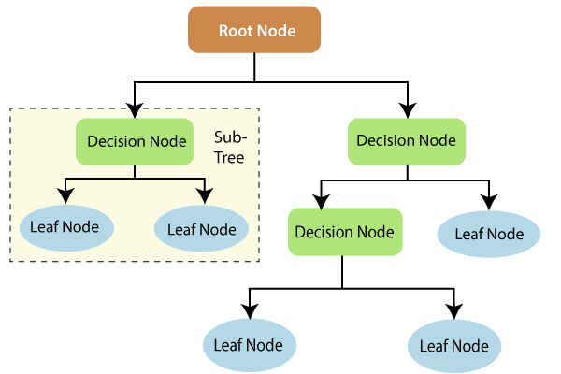
ALGORITHM USED
The algorithm on which the proposed system is built is the Random ForestClassifier Algorithm.
Random Forest is a classifier that contains a number of decision trees on various subsets of the given dataset and takes the average to improve the predictive accuracy of that dataset .

Slide 6
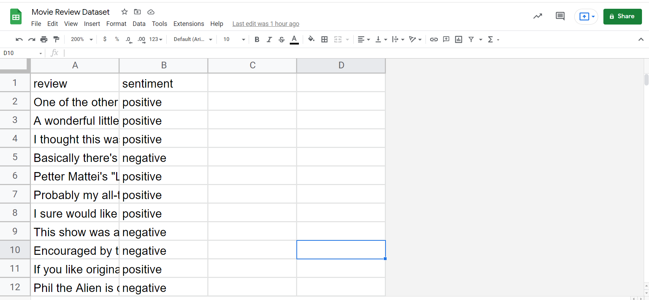
DATASET USED
(Movie Review Dataset)

Slide 7
IMPLEMENTATION ON TRAINING AND TESTING DATASET
GET THE DATA
DISCOVERY AND VISUALIZATION ON DATA
PERFORMING THE LABEL ENCODING
IMPLEMENTING ML ALGORITHM
ACCURACY ON TRAINING DATASET
ACCURACY ON TESTING DATASET

Slide 8
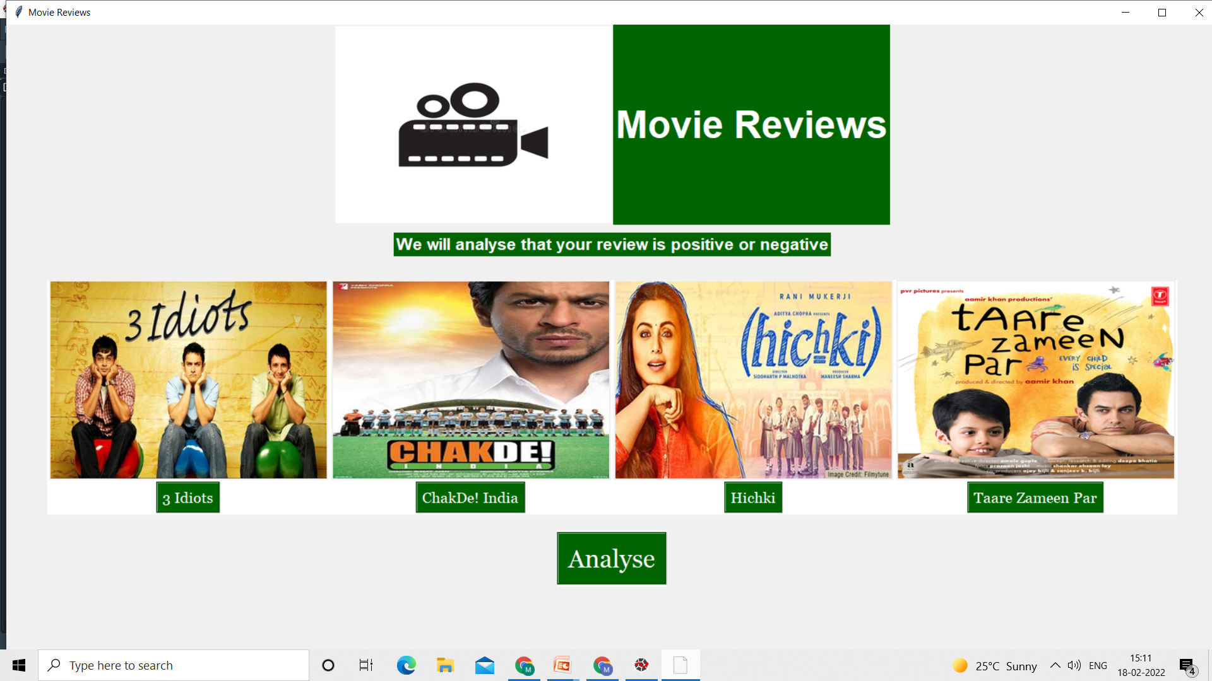
MAIN PAGE

Slide 9
RESULT ANALYSIS
From the analysis of the model, the Random Forest Classifier Algorithm proved to be the best suitable algorithm for the system.
This model is trained to predict that the review for the movie is positive or negative based on the basis of the user input for the trained features.

Slide 10
THANK YOU

